Slide 1
电池全生命周期健康管理系统
结题汇报
Jun. 7，2024
小组成员：王浩羽、李宗润、徐 涵
指导老师：卢周广、高 源、宋 轩
企业导师：袁 飞

Slide 2
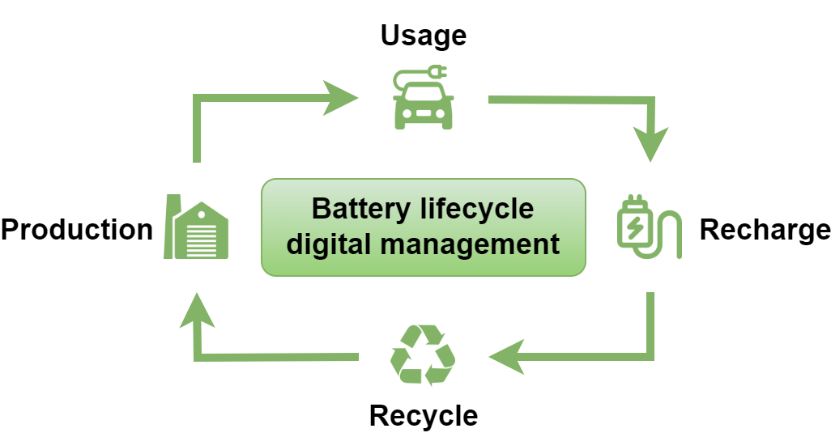

Background
Advantage：
Improve battery performance and safety
Provides support for the secondary utilization of batteries
2 / 45
Notes:
背景和意义的阐述需要清晰的说明项目的why的内容！为什么我们要做这个项目，基于哪些背景需求，解决了这些需求有什么意义，这些意义才是我们科研工作的研究价值。

Slide 3
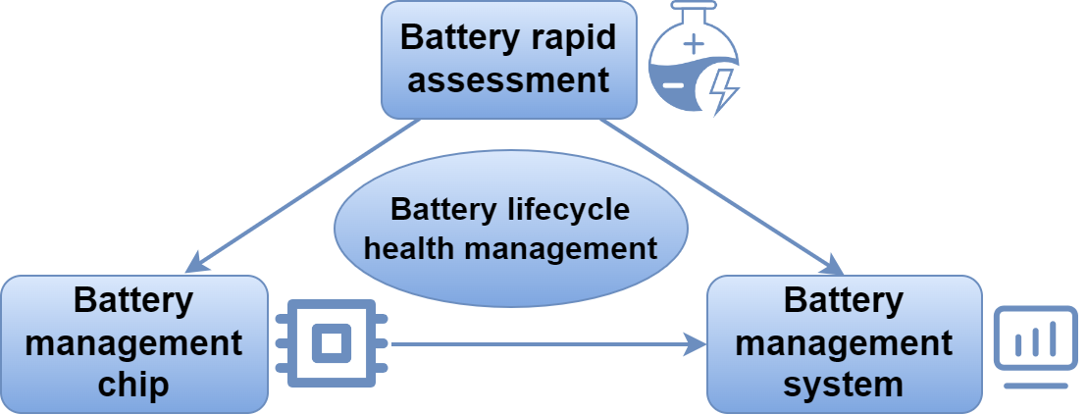
Background
材料科学与工程系
李宗润
深港微电子学院
徐涵
计算机科学与工程系
王浩羽
3 / 45
Notes:
背景和意义的阐述需要清晰的说明项目的why的内容！为什么我们要做这个项目，基于哪些背景需求，解决了这些需求有什么意义，这些意义才是我们科研工作的研究价值。

Slide 4
Part A: Materials Science
and Engineering
Test platform
Test process
Cycle and EIS test
李宗润

Slide 5
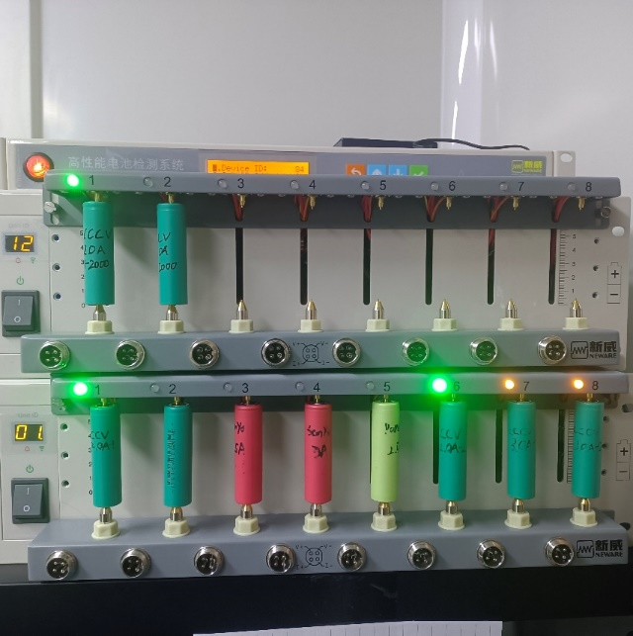
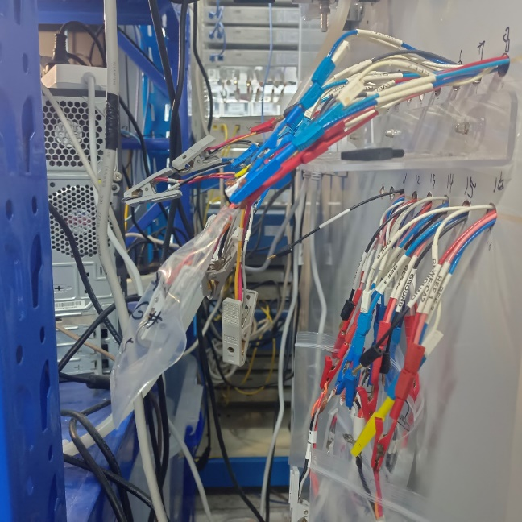
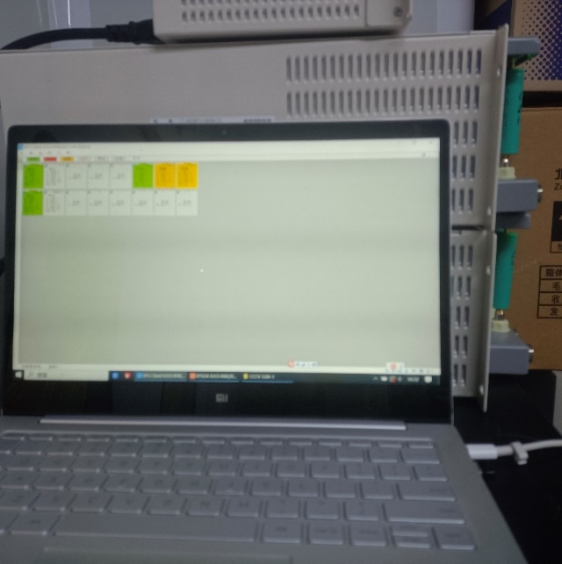
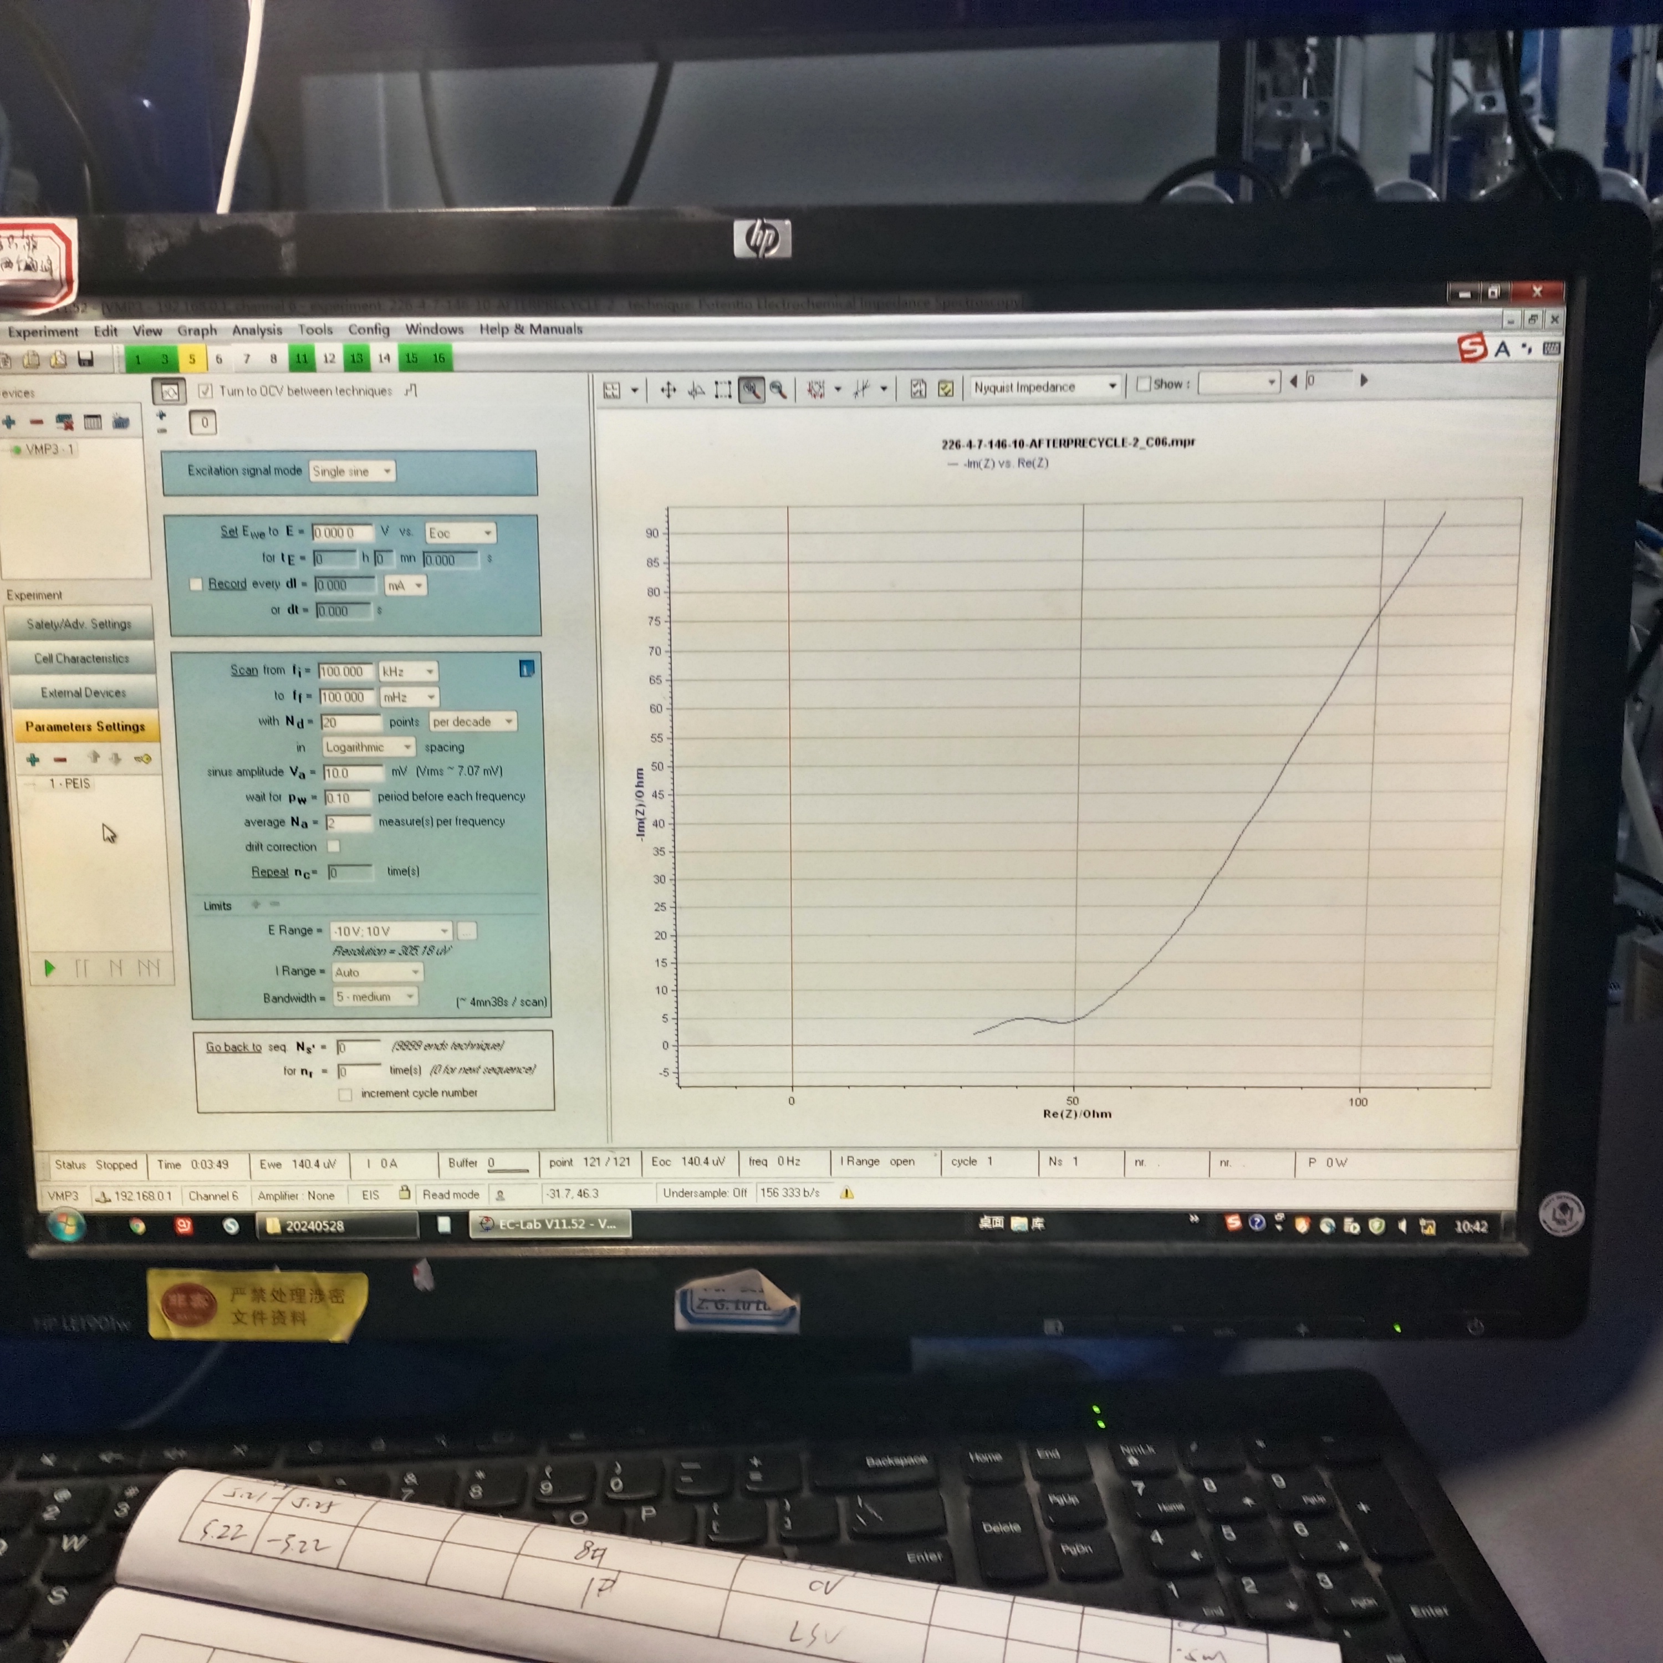
Test platform
Test platform:
Electrochemical Workstation
EIS test platform
Battery：
SANYO&PANA (4.3V)
18650 (4.3V)
Button battery: LIR2032 (3.6V)
Electrochemical Workstation
ElS Test Channel
Control Panel
5 / 45

Slide 6
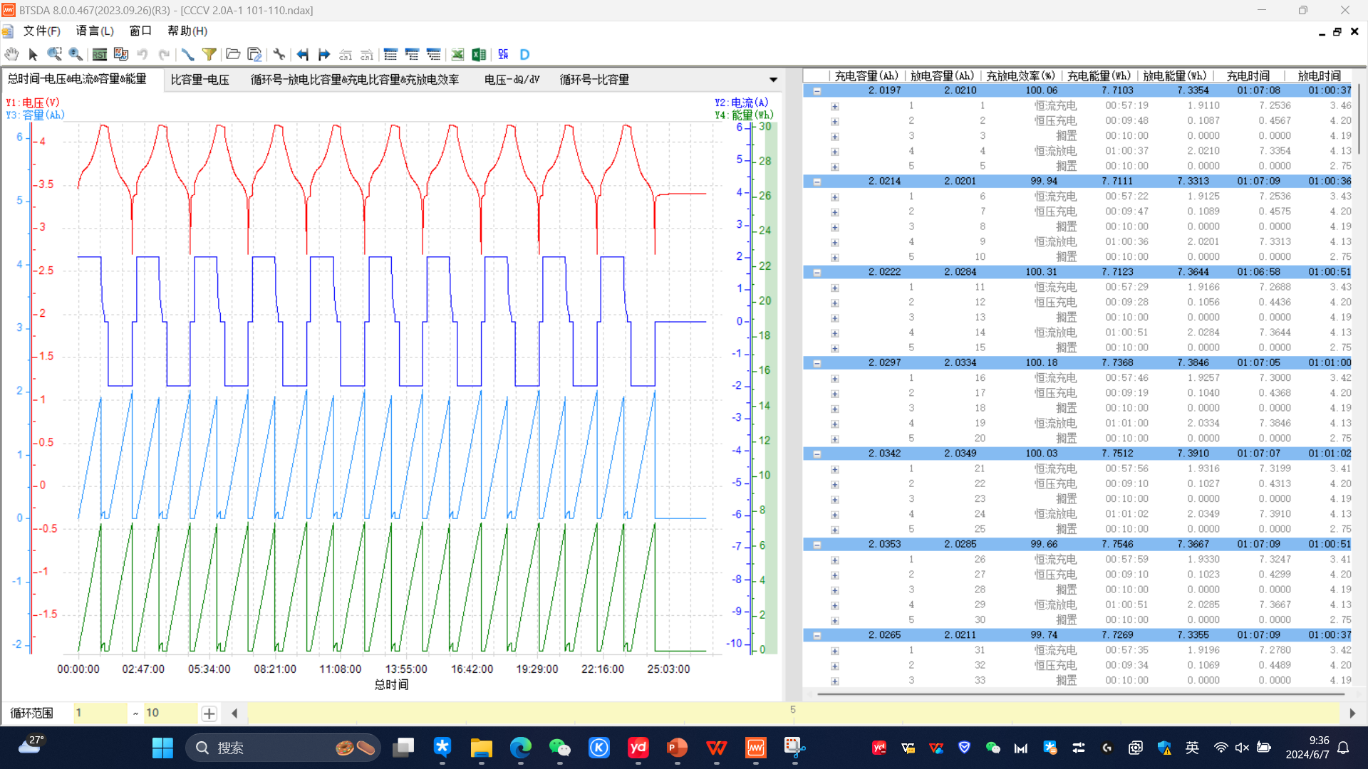
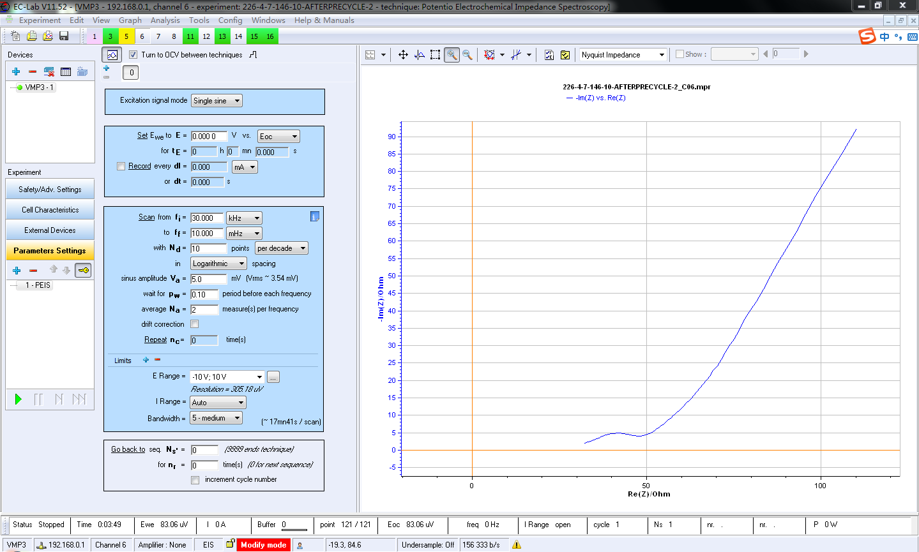
EIS test
BTSDA
EC-LAB
6 / 45

Slide 7
Test process
CC
CV
10 cycles
Record
EIS Test
Rest
Discharge
Record
7 / 45

Slide 8
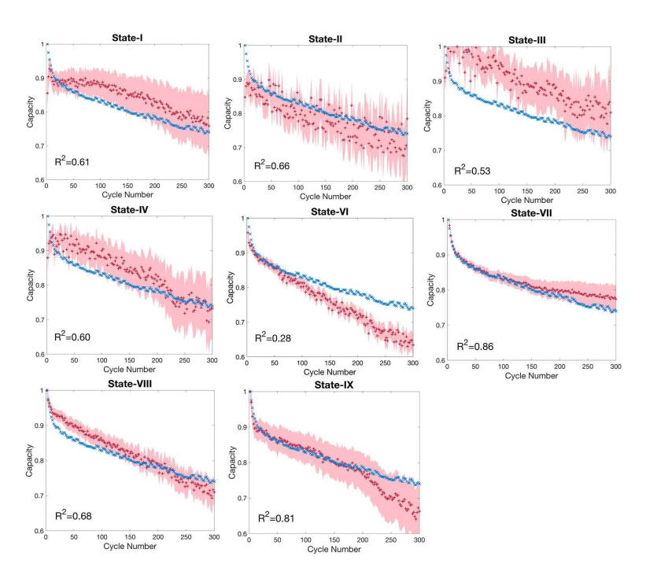
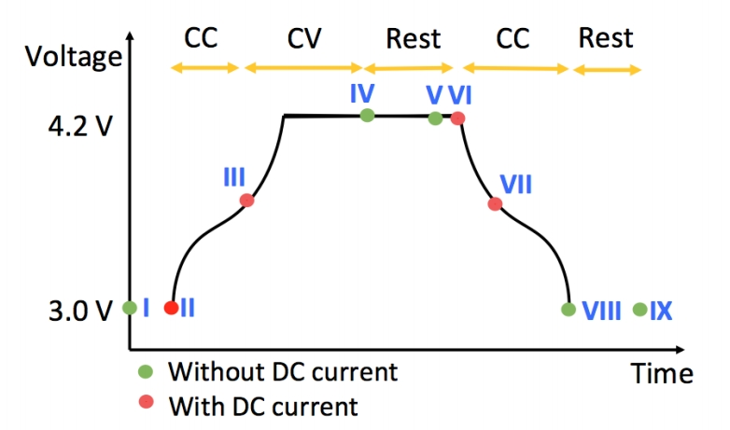
Test process
Data relativity in specific test time：
EIS Measurement States
Fitting Results
8 / 45
Data source: Identifying degradation patterns of lithium ion batteries from impedance spectroscopy using machine learning
https://zenodo.org/records/3633835

Slide 9
Part B:
Microelectronics
Hardware System Design
Data Collect
Data Processing
Compare and Analysis
徐涵

Slide 10
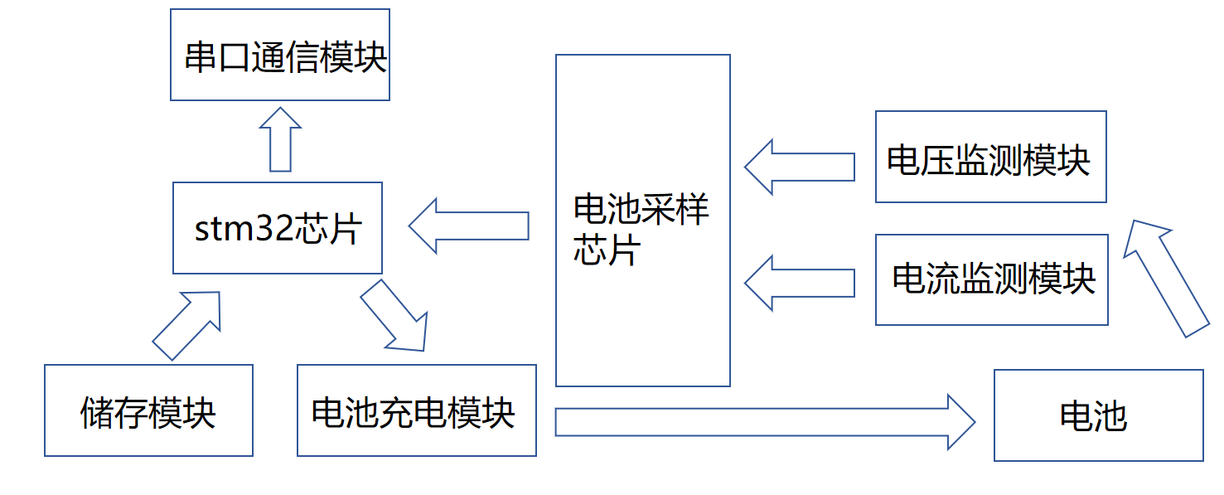
Hardware System Design
Voltage monitor：ADS1115
Current monitor：INA226
Battery charging：PW4035
Serial port communciation：CH340
Storage module：W25Q64
Objective: To measure the complete charge and discharge curve of the battery
Work: Set up the hardware circuit to charge and discharge the battery and sample the voltage and current
10 / 45

Slide 11
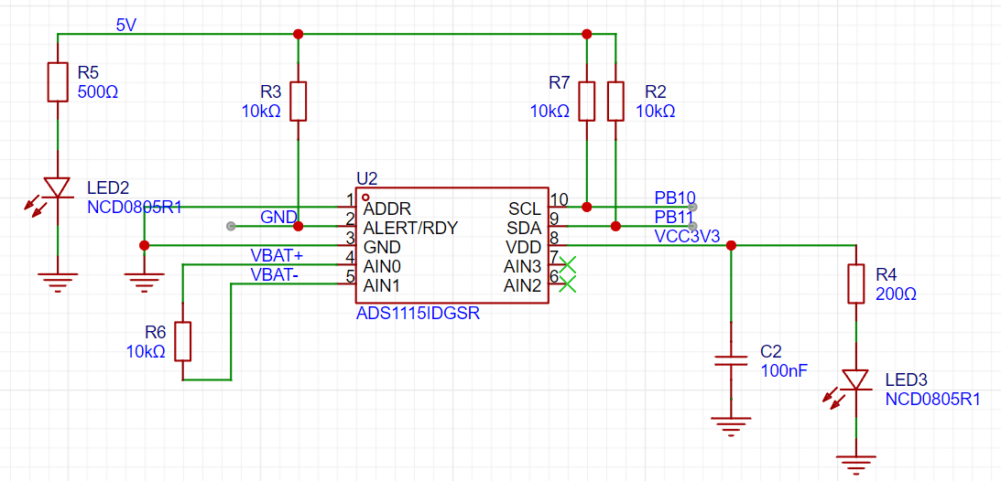
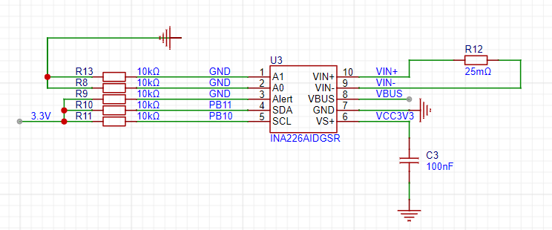
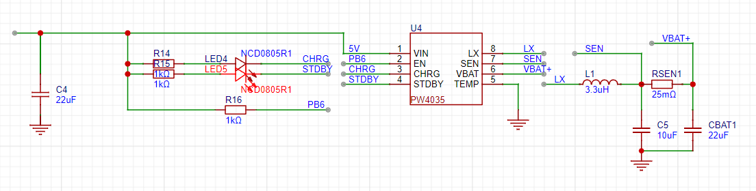
Schematic
Cuttent monitor：INA226
range：3.2A
LSB：0.1mA
Voltage monitor
ADS1115
range：6.144V
LSB：187.5uV
Battery charging：
PW4035
MAX current up to2A
constant current and constant voltage
11 / 45

Slide 12
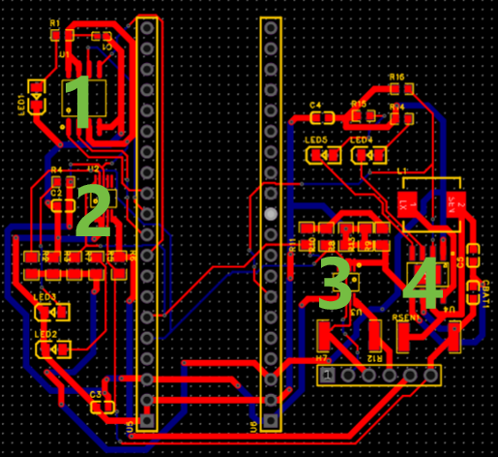
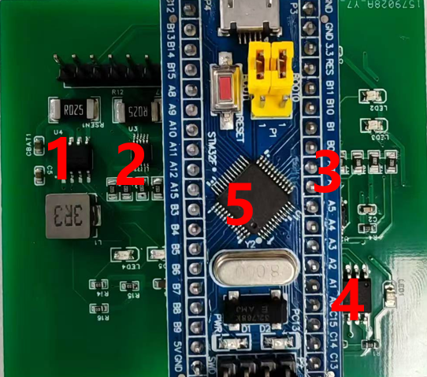
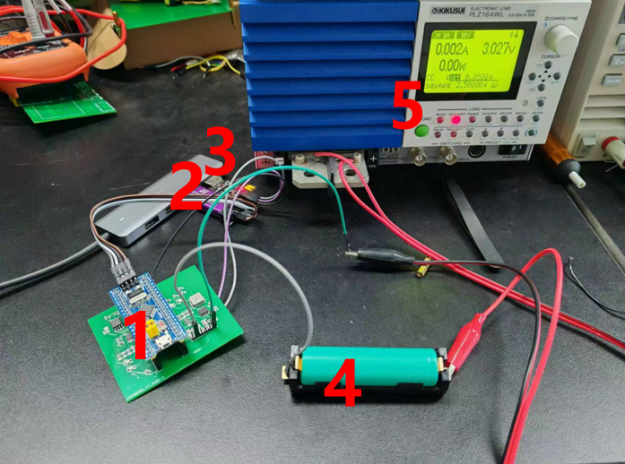
PCB
PCB
Real part
Test
1：W25Q64
2：ADS1115
3：INA226
4：PW4035
1：PW4035
2：INA226
3: ADS1115
4：W25Q64
5：STM32
1：PCB
2：STLINK
3: CH340
4：Battert
5：electronic device
12 / 45

Slide 13
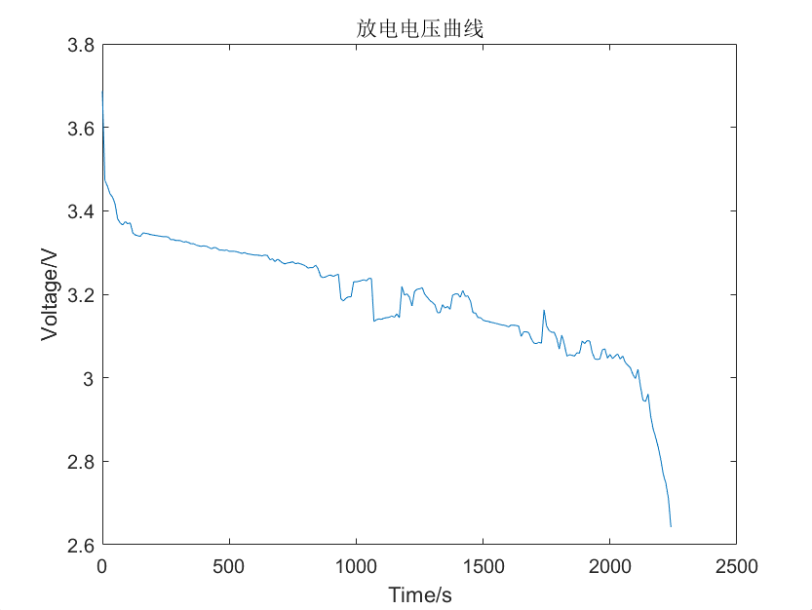
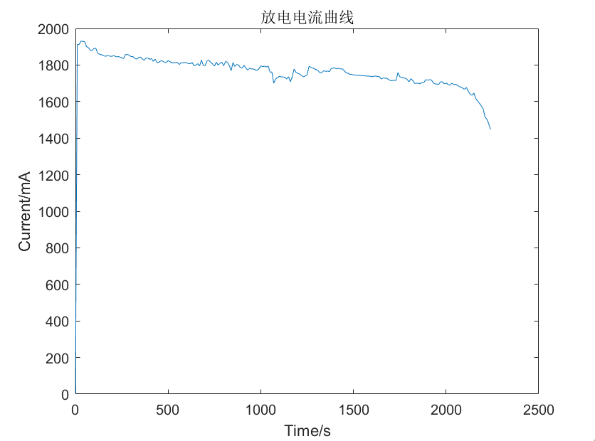
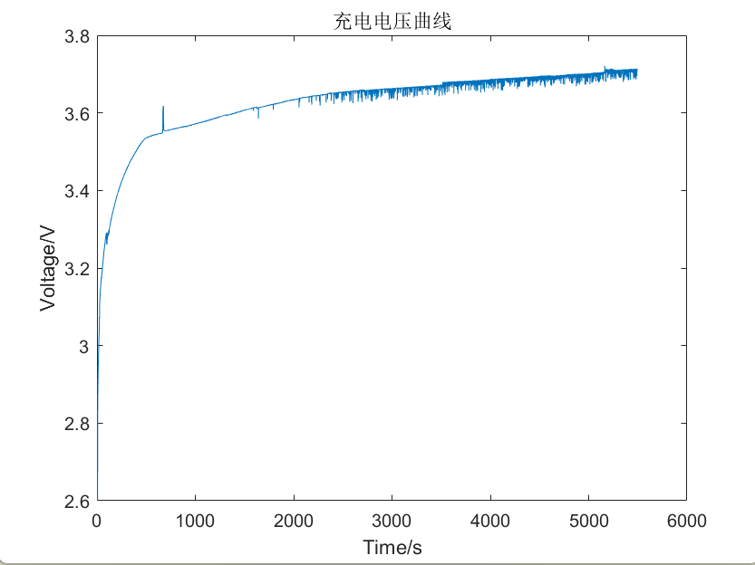
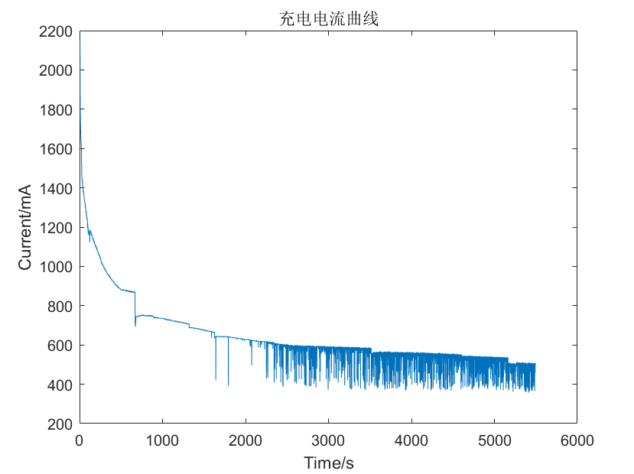
Data Collect
discharge voltage
discharge current
discharge curve
2A discharge
charge voltage
charge current
charge curve
13 / 45

Slide 14
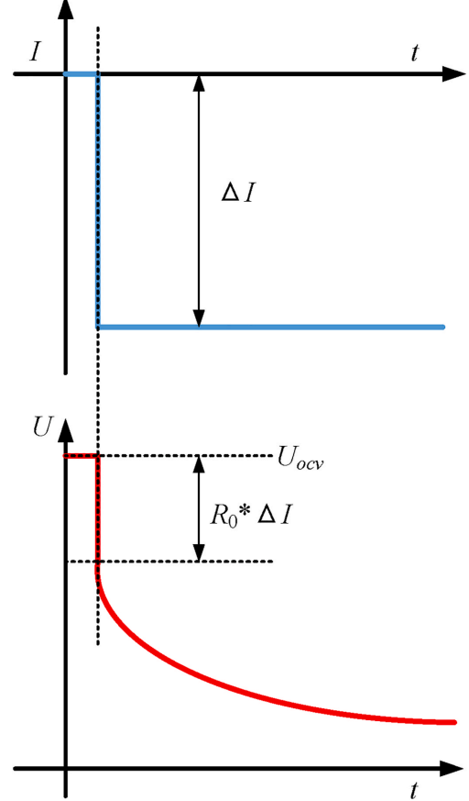
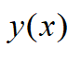
Date processing
discharge--EIS
impedance Z：
exponential decay
discharge
dZ：
；
DRT：
EIS
14 / 45

Slide 15
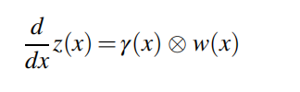
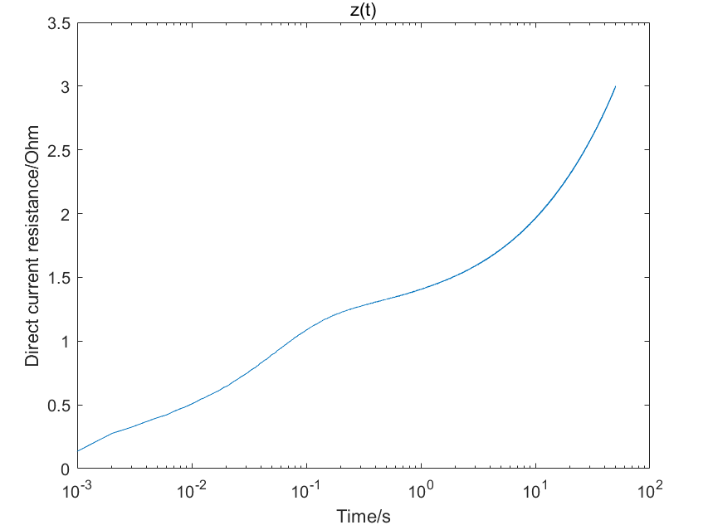
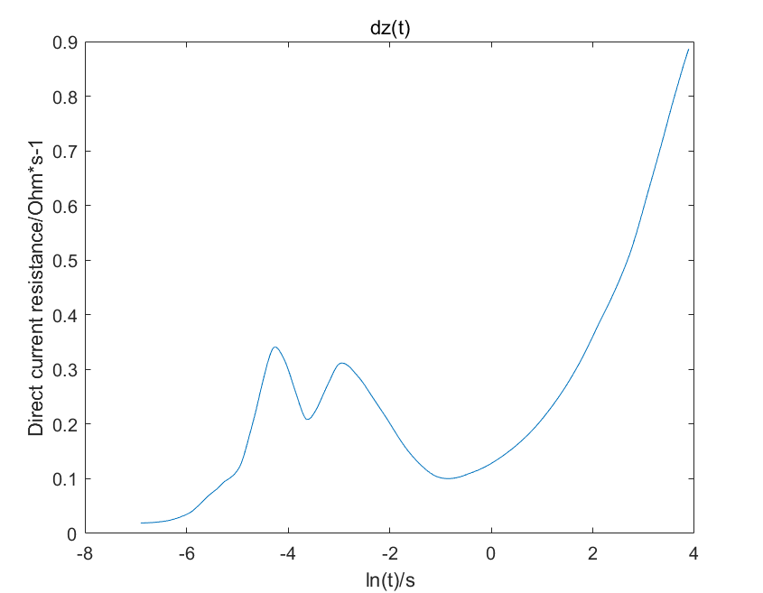
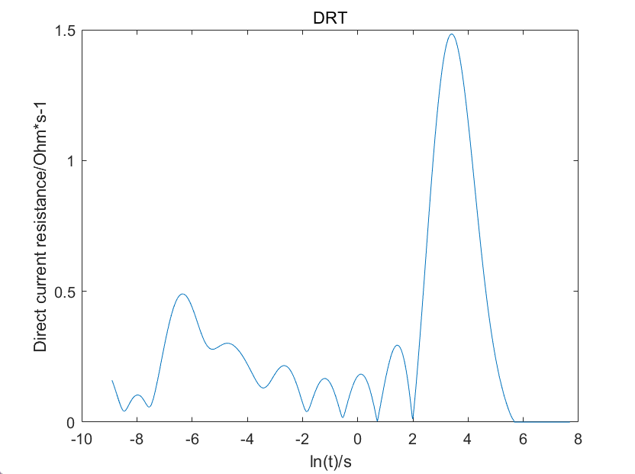
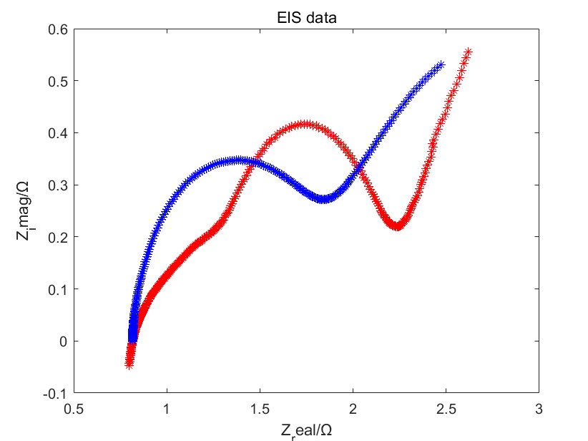
数据处理
discharge--EIS
0.001S sample frequency
50S sample time
Z：
Z
dZ
DRT
EIS
red: real EIS
blue: calculated EIS
15 / 45

Slide 16
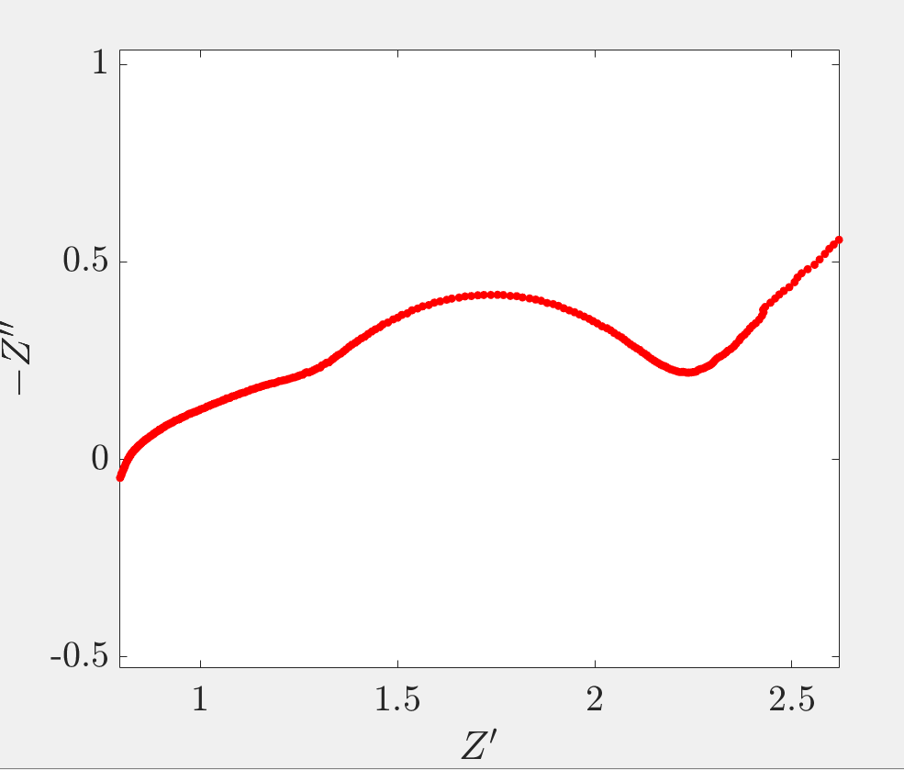
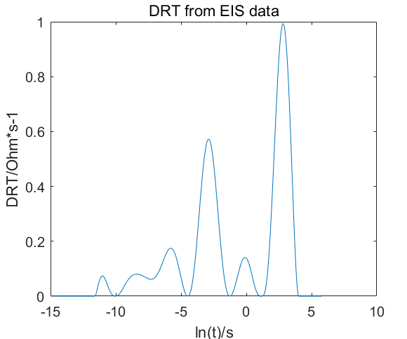
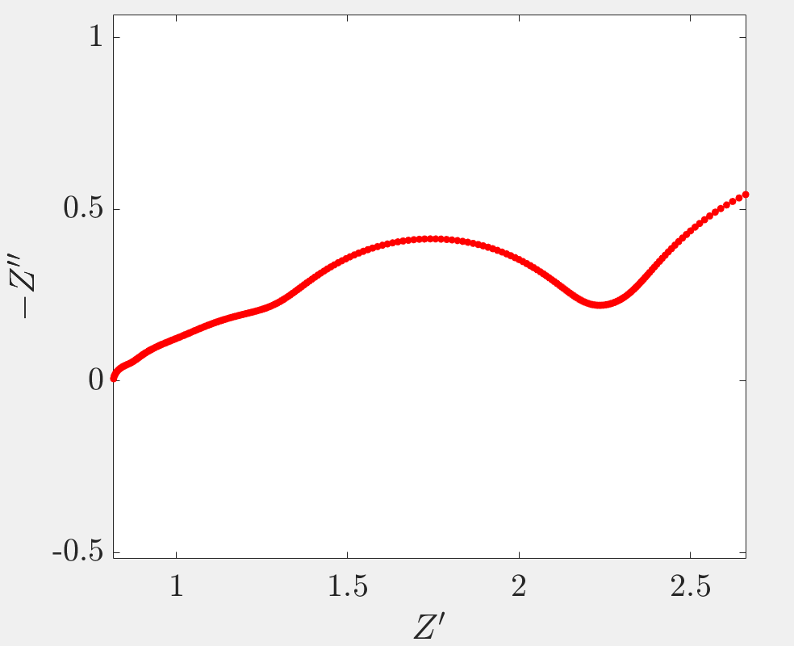
reverse：DRT→EIS
EIS（device）
DRT-tools^{[1]}
DRT
similarity ：
EIS and EIS（from DRT）
calculation correct
EIS（EIS-DRT-EIS）
16 / 45

Slide 17
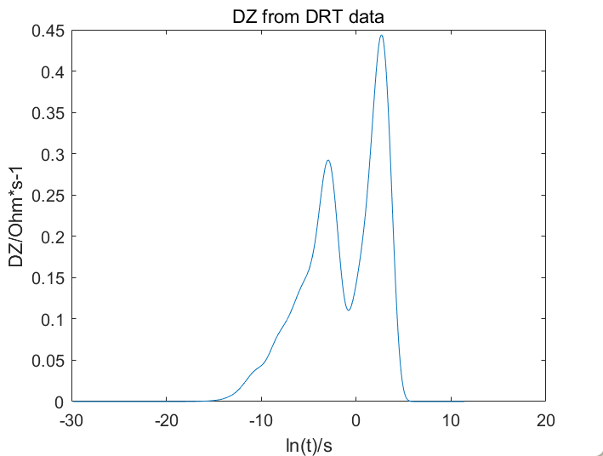
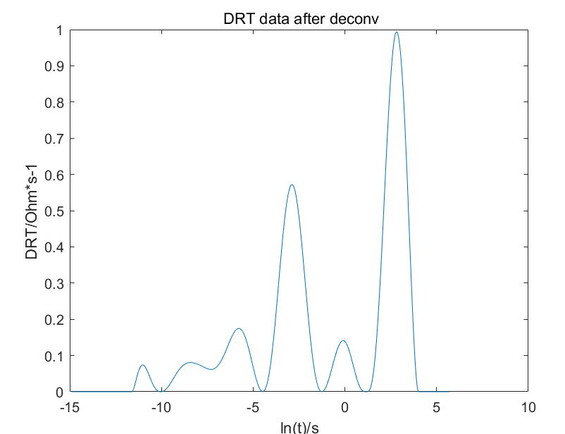
reverse：dZ→DRT
DRT（from EIS）
dZ
similarity ：
DRT and DRT（from dZ）
calculation correct
DRT（DRT-dZ-DRT）
17 / 45

Slide 18
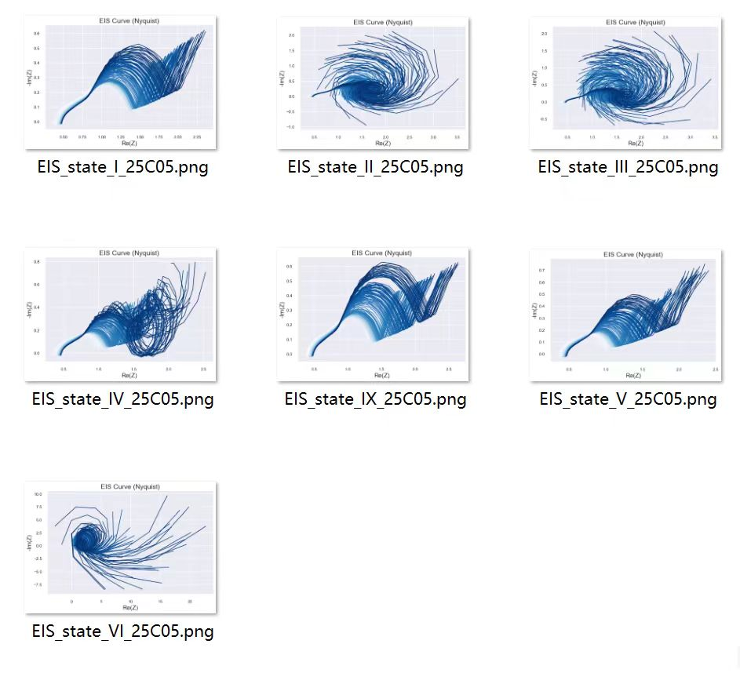
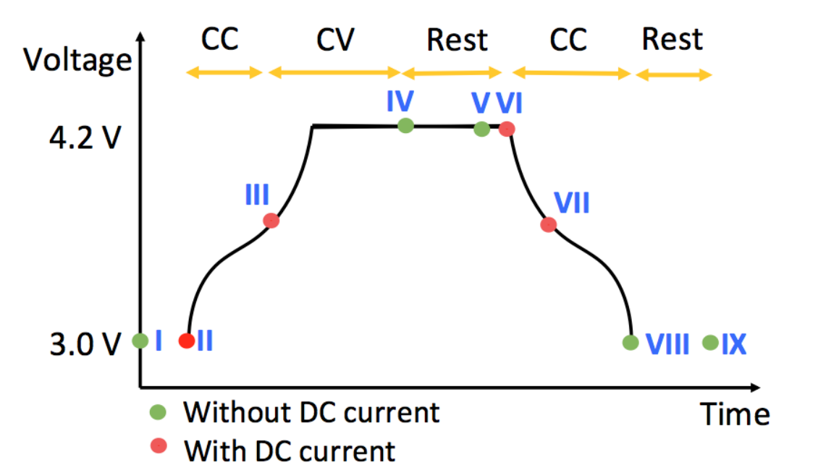
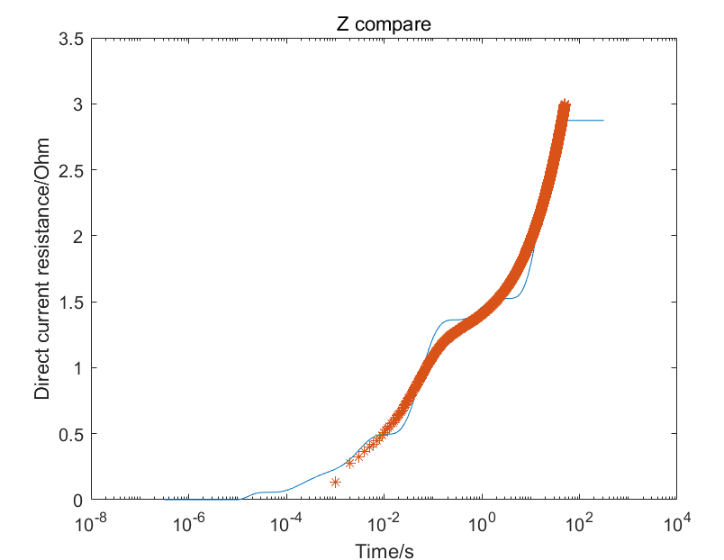
Compare and Analysis
Battery
EIS
Z（compare）
red: Z
blue: reverse Z
correct calculation but incorrect EIS
EIS change on various SOC
Battery cell not enough
Sample frequency not enough（1KHZ vs1MHZ）
18 / 45

Slide 19
Part C: Computer Science
and Engineering
Goals and Objectives
Proposed Methods
Experimental Results
Conclusion
System Demo
王浩羽

Slide 20
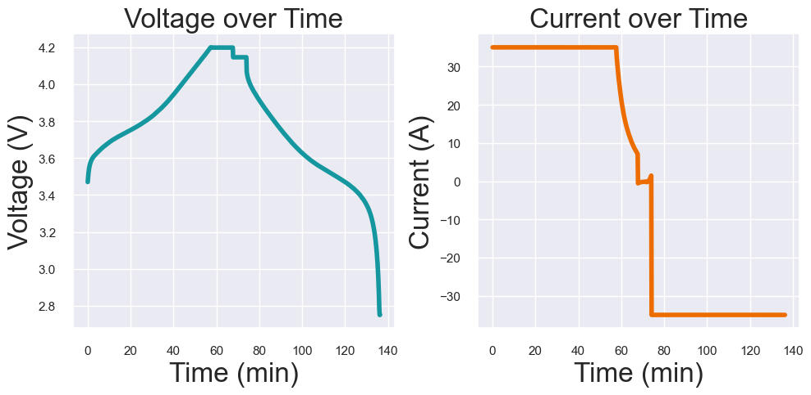
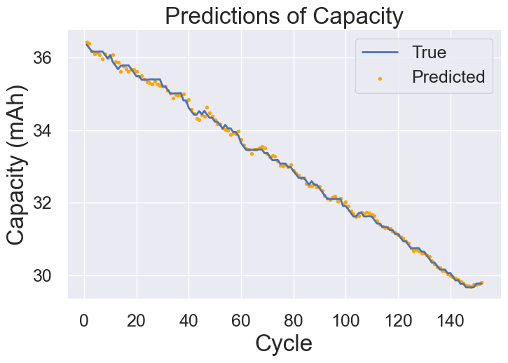
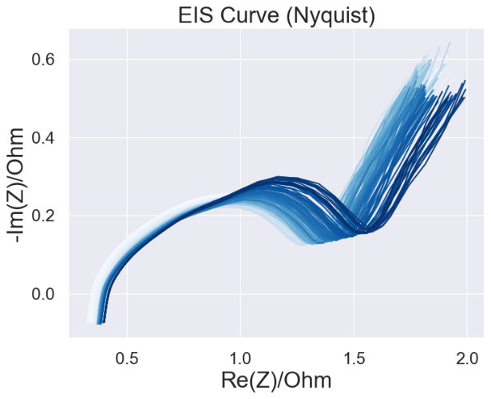
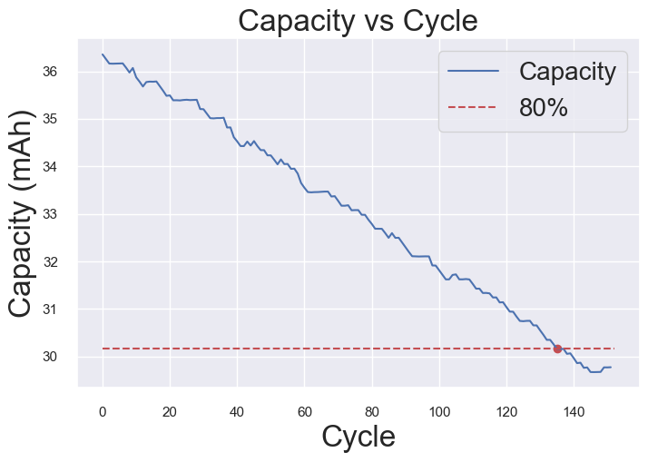
Goals and Objectives
Predict
Charging Curve
Capacity Degradation Curve
Estimate
EIS Profile
Remaining Useful Life (RUL)
20 / 45
Notes:
我们的目标是通过充放电曲线和EIS曲线两类电池数据，预测电池当前容量，并结合容量历史数据，进一步估计电池的剩余使用寿命RUL

Slide 21
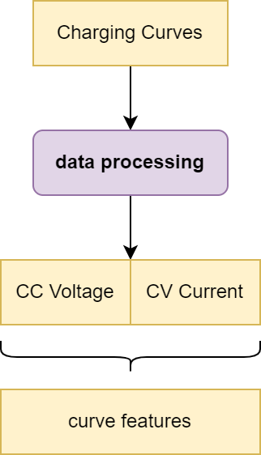
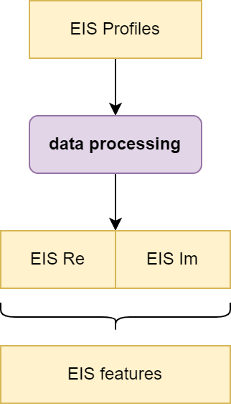
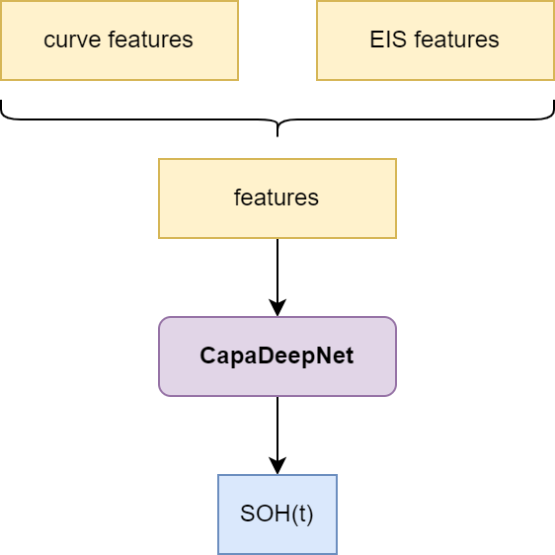
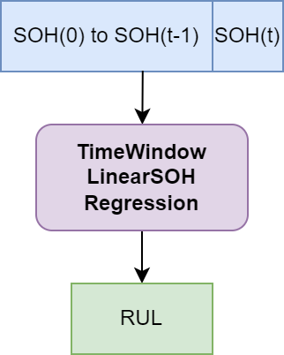
Proposed Methods
Step1
Data Processing
Step2
Predict Current Capacity
Calculate State of Health
(SOH)
Step3
Estimate
Remaining Useful Life
(RUL)
21 / 45
Notes:
可以看到，我们提出的方法共有三个步骤，步骤一为数据预处理，分布提取出充电曲线中电压和电流特征以及EIS曲线中实部和虚部特征，进而构成一个特征向量输入到第二步的DNN中获得预测的容量，也就是SOH，结合历史数据通过时间窗口线性回归模型，估计出RUL。

Slide 22
Proposed Methods
Step2: CapaDeepNet
Deep Neural Net for Battery Capacity Prediction
Hyper Params:
Epoch：50
Batch Size：16
DeepNet Structure:
 | layer | in-dim | out-dim
1 | FC | Feature-size | 32
2 | FC | 32 | 64
3 | FC | 64 | 72
4 | FC | 72 | 128
5 | FC | 128 | 64
6 | FC | 64 | 64
7 | FC | 64 | 32
8 | FC | 32 | 16
9 | FC | 16 | 8
10 | FC | 8 | 1
22 / 45
Notes:
这是我们的CapaDNN模型，由十个MLP层构成，超参设置如上

Slide 23
Dataset 1: 18650
Dataset 1 (Self-measuring):
6 Batteries of “18650”
battery | charging protocol | CC current | CV voltage | cycle
1 | CC-CV | 2.0A | 4.2V | 859
2 | CC-CV | 2.0A | 4.2V | 869
3 | CC-CV | 2.0A | 4.2V | 900
4 | CC-CV | 3.0A | 4.2V | 894
5 | CC-CV | 3.0A | 4.2V | 844
6 | CC-CV | 3.0A | 4.2V | 920
23 / 45
Notes:
我们的第一个数据集称之为18650，由六块18650电池构成，他们被分为两组，按照恒流充电的不同。前三块2.0A，后三块3.0A

Slide 24
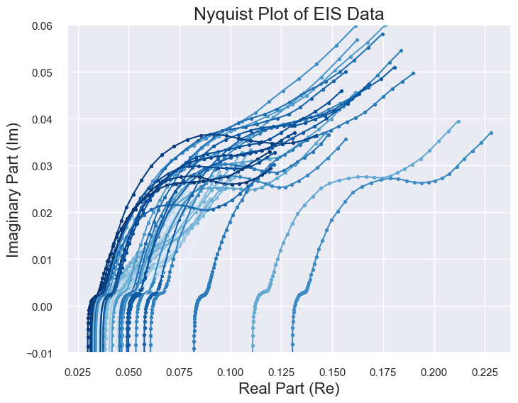
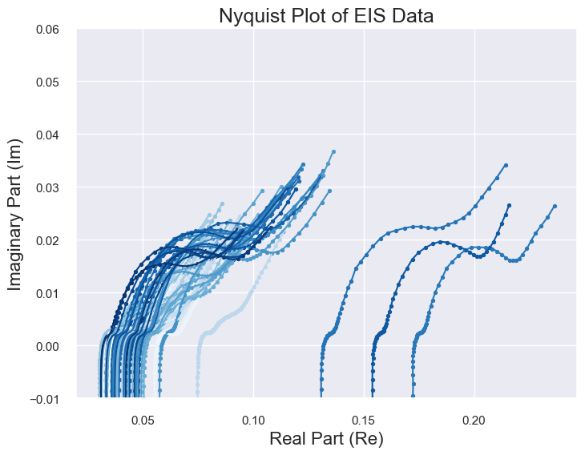
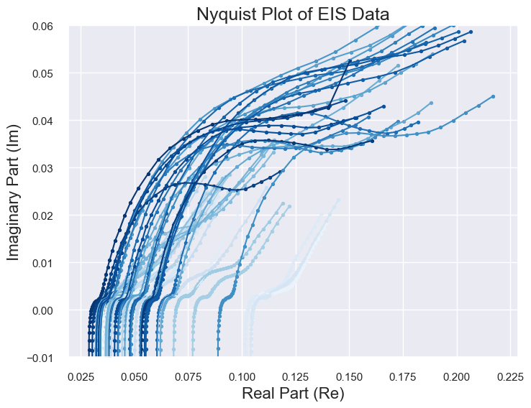
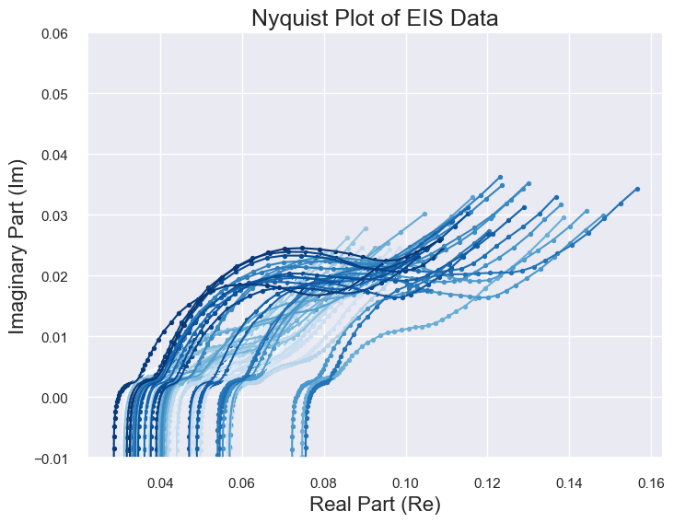
Dataset 1: 18650
EIS Profiles:
Can NOT Use due to
the INSTRUMENTs
24 / 45
Notes:
虽然我们也测量了该数据集的EIS，但是由于仪器问题，曲线杂乱无章，无法使用

Slide 25
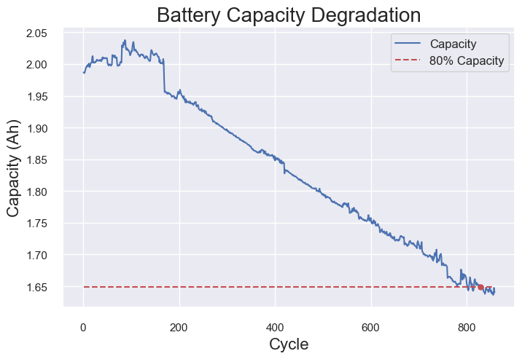
Dataset 1: 18650
Data in Dataset (Battery 1):
Only Charging Curve
Battery Charging Curves
(1 cycle)
Capacity Degradation Curve
25 / 45
Notes:
那么我们只能用它的充电曲线进行实验，右图为它的容量下降曲线

Slide 26
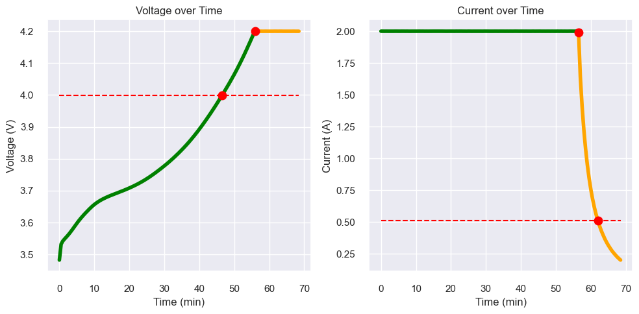



Dataset 1: 18650
Step1: Data Processing
CC Voltage
CV Current
CC
Voltage
Range
CC -> U: 4.0 ~ 4.2V
CV -> I: 2.0 ~ 0.5A
Sample points number
CC Voltage: 20
CV Current: 10
CV Current
26 / 45
Notes:
第一步，数据预处理，首先看上面两幅图，我们分别截取了CC部分的电压4.0-4.2V，和CV部分电流2.0A-0.5A，然后将截取区域全部绘制在一张图上得到下图。可以看到从白色到深蓝色是相当有规律的，这位后面的训练打下一个很好的基础。

Slide 27




Dataset 1: 18650 – Capacity Prediction
Step2: CapaDeepNet
Battery 1: Training Data
(training and validation)
Battery 2 and 3: Evaluation
27 / 45
Notes:
第一组实验结果，其中，我们使用电池1作为训练集，当然它本身也进一步分割为训练和测试两部分。电池2和3不参与训练，只作为测试集衡量模型性能。可以从拟合结果中看到，结果非常的好，最大平均相对误差不超过1%

Slide 28




Dataset 1: 18650 – Capacity Prediction
Step2: CapaDeepNet
Battery 4: Training Data
(training and validation)
Battery 5 and 6: Evaluation
28 / 45
Notes:
第二组同理，电池6虽然平均相对误差超过了1%，但是这也是由于尾部拟合不够好的原因造成的，由图中也可以看出

Slide 29






Dataset 1: 18650 – RUL Estimation
Step3: Time-window Linear Regression
Time-window
440-540 cycles
540-640 cycles
Battery 1
Battery 2
Battery 3
29 / 45
Notes:
这是时间窗口线性回归模型，我们展示了440-540，540-640这两组时间窗口，可以观察到在容量下降的后半部分，它保持了比较好的线性性

Slide 30






Dataset 1: 18650 – RUL Estimation
Step3: Time-window Linear Regression
Time-window
460-560 cycles
520-620 cycles
Battery 4
Battery 5
Battery 6
30 / 45

Slide 31








Dataset 2: 3633835
https://zenodo.org/records/3633835
Choose Battery: 25C05
(from 8 batteries)
Choose state V
Open-source; EIS Only
I
II
III
IV
V
VI
IX
Data source: Identifying degradation patterns of lithium ion batteries from impedance spectroscopy using machine learning
https://zenodo.org/records/3633835
31 / 45
Notes:
第二个数据集，3633835，它是一个开源数据集，我们选择了电池25C05开展实验，它包含多个state的EIS，我们选取V，原因是其他很多EIS没有规律，只有1，5，6具有较好的可解释性，原论文选用了V，因此我们也使用V进行进一步研究

Slide 32


Dataset 2: 3633835 – Capacity Prediction (Interval)
Choose Battery: 25C05
EIS Features (Method 1): Interval of Re/Im Segments
EIS Features
(for all cycles)
32 / 45
Notes:
那么这是我们截取的EIS的实部和虚部，所有cycle均绘制在图上

Slide 33



Dataset 2: 3633835 – Capacity Prediction (Interval)
Step2: CapaDNN
Capacity Degradation Curve
Prediction results
33 / 45
Notes:
可以看到，数据集中给出了较多的循环周期，但是红线之后的数据我们并不关心。预测结果很好

Slide 34


Dataset 2: 3633835 – Capacity Prediction (Characters)
Choose Battery: 25C05
EIS Features (Method 2): EIS Characters
EIS Characters
(for 1 cycle)
EIS Features
(for all cycles)
34 / 45
Notes:
我们使用了另一种方法去完成这项任务，分别选取一条EIS曲线的峰值、谷值、欧姆阻抗、频率0.1处以及过零点的直线与曲线切点，将它们的实部、虚部、以及两者平方和开根号提取出来绘制在右图中。可以看到，变化具有高度的规律性。
（欧姆阻抗当然虚部肯定是0，平方和开根号也等于实部，简单起见我也没处理俩东西）

Slide 35

Dataset 2: 3633835 – Capacity Prediction (Characters)
Step2: CapaDNN
0.4308
0.91%
0.3170
0.78%
Capacity Degradation Curve
Prediction results
35 / 45
Notes:
拟合结果如图，发现平均相对误差只有0.78%

Slide 36
Dataset 2: 3633835 – Comparison
Step2: CapaDNN:
Mean Relative Error:
1.23% =====>>>>>> 0.78%
Method1: Interval
Method2: Characters
36 / 45
Notes:
第二种方法，在选取了更少的数据点的情况下，获得了比方法一更好的结果，这体现了特征提取的有效性

Slide 37





Dataset 2: 3633835 – RUL Estimation
Step 3:
Time-window Linear Regression
40–60 cycles
50–70 cycles
Model shows a poor Robustness!
60–80 cycles
70–90 cycles
37 / 45
Notes:
RUL估计结果，我们发现从2.62%到9%以上，结果变化剧烈，这意味现在的模型在鲁棒性上表现较差

Slide 38


Dataset 3: Button Cell
Self-measuring
Single Battery Only
Capacity Degradation Curve
EIS Profile
38 / 45
Notes:
纽扣电池数据集包含一块纽扣电池，它的特点是同时具有EIS曲线和充放电曲线

Slide 39


Dataset 3: Button Cell
Features
Charging Curve
Features
(for all cycles)
EIS Features
(for all cycles)
39 / 45
Notes:
上图和下图分别是我们提取到的充电曲线和EIS曲线

Slide 40







Dataset 3: Button Cell - Results
Step 3: Time-window Linear Regression
Step2: CapaDNN
40 / 45
Notes:
容量预测结果在左侧，平均相对误差只有0.24%，相当不错了。右边是RUL回归结果，同样有鲁棒性较差的问题

Slide 41








Dataset 4: NASA (Deprecated)
Totally Ridiculous!
EIS Profiles for Several Batteries
41 / 45
Notes:
我们同样探索了市面上其他开源数据集，但是并没有很大同时具有充放电和EIS曲线的开源数据集，如NASA的EIS完全无法使用

Slide 42
Conclusion
To enhance the Accuracy and Applicability of our model,
For CapaDNN:
Good enough for LAB datasets
Collect more realistic data from REAL USAGE
For Time-window Linear Regression:
Effective for some cases
Poor Robustness
Sensitive to Abnormal value
42 / 45
Notes:
结论：纯念PPT就行

Slide 43

System Demo
Demo Web
43 / 45

Slide 44
Reference
1．Wang, S., Jin, S., Bai, D., Fan, Y., Shi, H., & Fernandez, C. (2021). A critical review of improved deep learning methods for the remaining useful life prediction of lithium-ion batteries. Energy Reports, 7, 5562–5574. https://doi.org/10.1016/j.egyr.2021.08.182
2．Ansari, S., Ayob, A., Hossain Lipu, M. S., Hussain, A., & Saad, M. H. M. (2022). Remaining useful life prediction for lithium-ion battery storage system: A comprehensive review of methods, key factors, issues and future outlook. Energy Reports, 8, 12153–12185. https://doi.org/10.1016/j.egyr.2022.09.043
3．Wang, S., Jin, S., Deng, D., & Fernandez, C. (2021). A Critical Review of Online Battery Remaining Useful Lifetime Prediction Methods. Frontiers in Mechanical Engineering, 7. https://doi.org/10.3389/fmech.2021.719718
4．Park, K., Choi, Y., Choi, W. J., Ryu, H.-Y., & Kim, H. (2020). LSTM-Based Battery Remaining Useful Life Prediction With Multi-Channel Charging Profiles. IEEE Access, 8, 20786–20798. https://doi.org/10.1109/access.2020.2968939
5．Xu, Q., Wu, M., Khoo, E., Chen, Z., & Li, X. (2023). A Hybrid Ensemble Deep Learning Approach for Early Prediction of Battery Remaining Useful Life. IEEE/CAA Journal of Automatica Sinica, 10(1), 177–187.
https://doi.org/10.1109/jas.2023.123024
6．Lu, J., Xiong, R., Tian, J., Wang, C., & Sun, F. (2023). Deep learning to estimate lithium-ion battery state of health without additional degradation experiments. Nature Communications, 14(1). https://doi.org/10.1038/s41467-023-38458-w
7．Zhang, Y., Tang, Q., Zhang, Y., Wang, J., Stimming, U., & Lee, A. A. (2020). Identifying degradation patterns of lithium ion batteries from impedance spectroscopy using machine learning. Nature Communications, 11(1). https://doi.org/10.1038/s41467-020-15235-7

Slide 45
谢谢大家！ 请各位老师批评指正！

Slide 46








Appendix:
3633835 dataset
Capacity Degradation Curves
For 8 Batteries

